Slide 1
R&S IM Spacing Sweep Development Plan
Nick Lalic
VNA Software Developer
Rohde & Schwarz North America

Slide 2
Functionality
Measure intermodulation as a function of tone spacing (Initial, Final, Points)
Settings:
Lower tone port
Upper tone source (port, external generator)
Receiving Port
Source for Receiver Cal
Center Frequency (Hz)
Initial Tone Spacing (Hz)
Final Tone Spacing (Hz)
Points
Power (dBm)
IF BW (Hz)
IF Selectivity (Normal | Medium | High)

Slide 3
Functionality
Traces (output):
<Type> <Side> <Order> <Location> Where
Type: IM | IP | Tone
Side: Upper | Lower | Major
Order: 3 | 5 | 7 | 9
Location: Input | Output
Traces displayed in VNA Firmware

Slide 4
User Interface
Wizard
Page 1 – Settings (ports, tone spacing, power, IF BW etc)
Page 2 – Traces
Pages 3-5 (Optional)
Lower tone power cal
Upper tone power cal
Receiver power cal

Slide 5
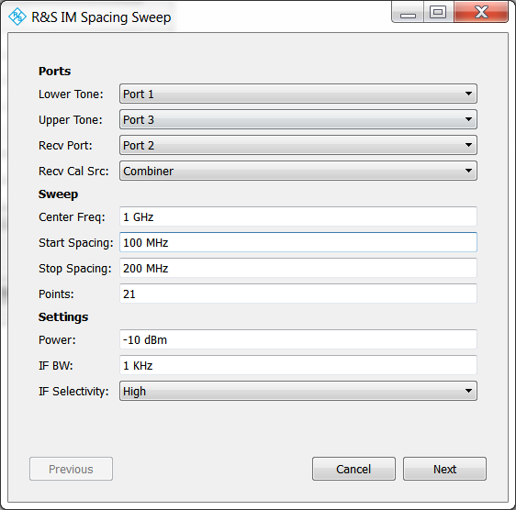
User Interface
Settings

Slide 6
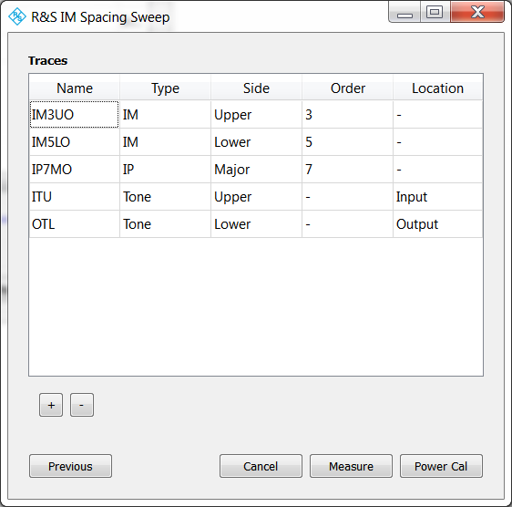
User Interface
Traces

Slide 7
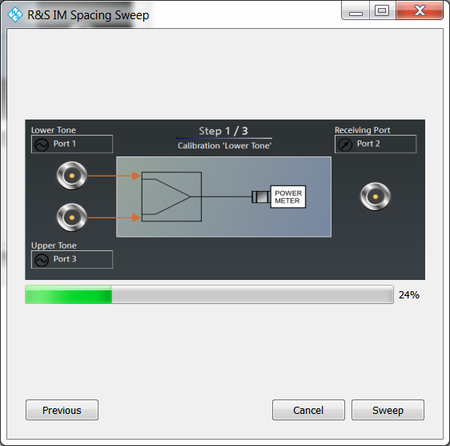
User Interface
Lower Tone Power Cal

Slide 8
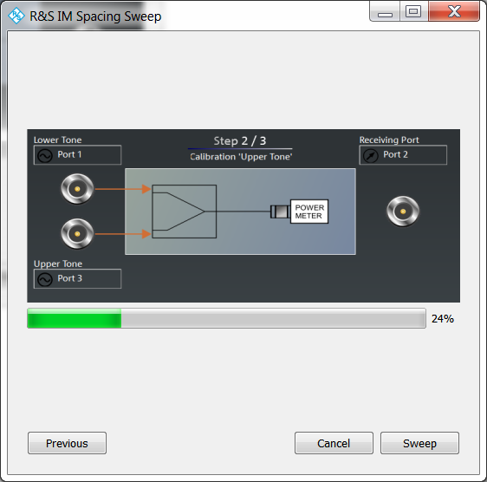
User Interface
Upper Tone Power Cal

Slide 9
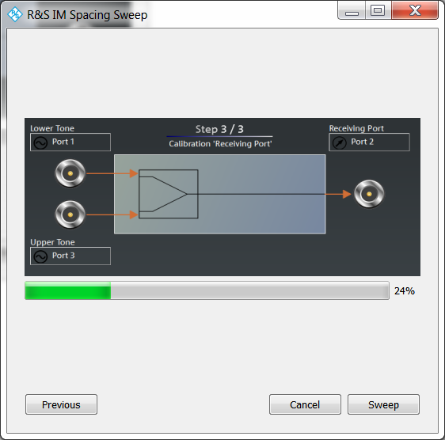
User Interface
Receiver Power Cal

Slide 10
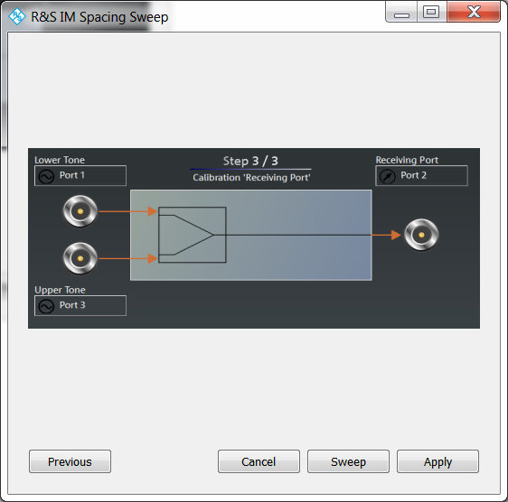
User Interface
Apply All

Slide 11
Development Effort
Implement and Test ~10 SCPI commands in VNA driver:
Set lower tone port
Set upper tone source
Set Receiver port
Set tone spacing (iterative)
Set IF BW Selectivity
Set measured intermodulation products (order 3-7)
Set trace type (IM, IP or Tone)
Power cal lower tone
Power cal upper tone
Power cal receiver
Approximately 1 week

Slide 12
Development Effort
Implement and Test data structures:
Settings (lower port, upper source, receiver, …)
Trace (name, type, order, side, location)
Result, Results
Implement and Test classes:
ConfigureIntermod(input: settings, traces, vna)
SourcePowerCal(input: settings, vna)
ReceiverPowerCal(input: settings, vna)
MeasureOne(input: settings, current_spacing, vna) => Result
Measure(input: settings, vna) => Results
CreateTraces (input: traces, vna)
Implement and Test widgets (GUI):
TracesModel
TracesDelegate
Approximately 2 weeks

Slide 13
Development Effort
Images (power cal)
Integration and Test
Installer
Real-world testing
Approximately 1 week
Total: Approximately 1 month development time to release
With other commitments: 1-2 months

